Slide 1


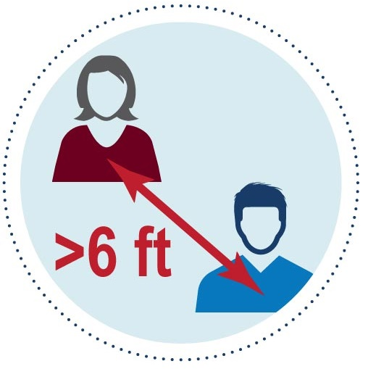



No drop-in usage
Yes, schedule in advance
Yes, empty room (15 min) between users
Yes, gloves & masks, even when alone
with microscope!
ALL USERS!!!
Wear face masks, even at microscope
Good hand hygiene
Maintain social distancing
Clean up (disinfect) after done
Any symptoms? Go home!
Max Occupancy = 1
Only 1 user at a time.
Wait until prior user leaves the room
before entering room.
Notes:
To be posted outside rooms

Slide 2

ALL USERS!!!
Wear face masks,
even at microscope
Wear gloves
Clean up (disinfect) after done
Any symptoms? Go home!
LSM780
LSM800
LSM880
END of SESSION
Clean spills; Clean immersion oil
Disinfect with
Moisten towel, then wipe:
Countertops
Desktops
Plastic-wrapped
  Eyepieces
  Focus knob
  Keyboard
  Mouse
  Touchpad
Doorknobs
Confirm plastic wrap intact
Remove, disinfect & replace
if necessary
Discard old gloves and plastic
wrap into biohazard waste
Leave IMMEDIATELY after
disinfecting to let air clear
START of SESSION
Fresh gloves
Disinfect if
necessary
Confirm no spills,
no immersion oil
on lenses
Confirm plastic wrap intact
  Eyepieces
  Keyboard
  Mouse
  Touchpad
  Remove, disinfect & replace
  if necessary
70% Ethanol
Keep surface damp 30s
Protect the
community!
Max Occupancy = 1
Only 1 user at a time.
Wait until prior user leaves the room
before entering room.
Notes:
To be posted next to microscopes. To minimize confusion, remove other signs about cleaning microscope.

Slide 3

ALL USERS!!!
Wear face masks,
even at microscope
Wear gloves
Clean up (disinfect) after done
Any symptoms? Go home!
LSM780
LSM800
LSM880
DAILY (early in day)
Re-stock supplies
Immersion oil
Lens paper
70% Ethanol/water (v/v)
Towels for disinfecting
Plastic wrap
Newspaper bags
Clean/Tidy up: Confirm no spills,
no immersion oil on lenses
Remove/Discard all plastic wraps
Disinfect with 70% Ethanol
Moisten towel, then wipe:
Countertops
Desktops
Eyepieces (Lens paper only)
Focus knob
Keyboard
Mouse
Touchpad
Doorknobs
Re-wrap with plastic wrap:
Eyepieces
Focus knob
Keyboard (newspaper bag)
All waste into Biohazard
70% Ethanol:
Keep surfaces damp 30s
to disinfect
Mouse
Touchpad
Notes:
To be posted next to microscopes. To minimize confusion, remove other signs about cleaning microscope.

